Slide 1






Resolve the continuous diurnal cycle of high-resolution ECOSTRESS evapotranspiration (ET) and land surface temperature (LST)
Jiaming Wen (jw2495@cornell.edu), Ph.D. candidate
Soil and Crop Science, School of Integrative Plant Sciences, Cornell University
Published at Water Resources Research (doi: 10.1029/2022WR032227)
Coauthors: Joshua B. Fisher (UCLA), Nicholas C. Parazoo (JPL), Leiqiu Hu (UAH),
Marcy E. Litvak (UNM), Ying Sun (Cornell)
RS group discussion 11/7/2022
1
Image source: https://gisgeography.com/farming-agriculture-technology/

Slide 2
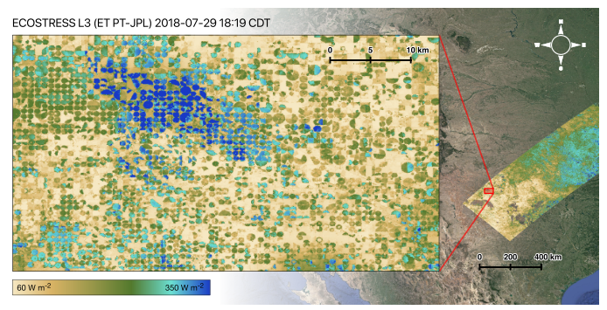
Great demand in water monitoring at both high spatial (sub-field) and temporal (hourly) resolutions
Common remote sensing based ET products
Landsat
Senay 2018
16d
LST and ET
Spatial: 70m
Temporal: 1-5 days
Upscaled FLUXNET ET
Jung et al. (2011, 2019)
Trade-off between spatial and temporal resolutions
Global products are either with low spatial resolution (~5km) or low temporal resolution (>=8d), or both
8d
MODIS
Mu et al. (2011)
Running et al. (2017)
BESS
Jiang and Ryu (2016)
Temporal Resolution (time)
3d
ECOSTRESS
Fisher et al. (2020)
Anderson et al. (2021)
1d
Upscaled FLUXNET ET
Bodesheim et al. (2018)
GOES
Fang et al. (2019)
GLEAM
Miralles et al. (2011)
Fisher et al. (2020)
1h
0.1
1
2
4
8
20
50
Spatial Resolution (grid size, km)

Slide 3
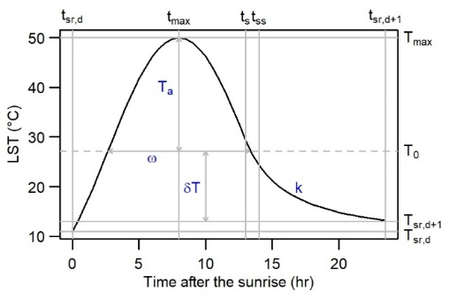

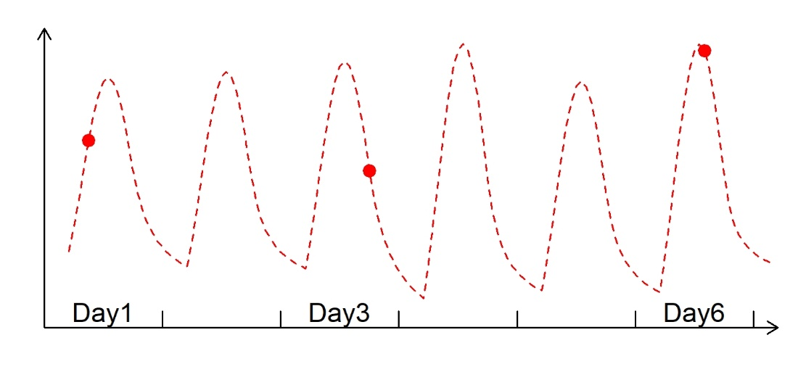
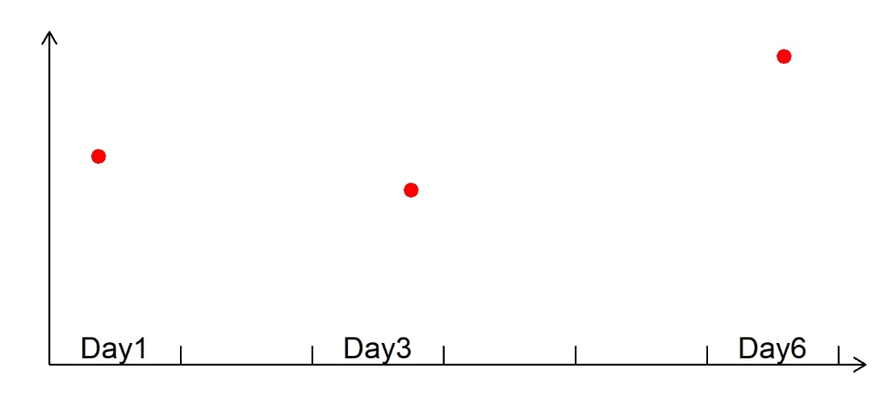
Diurnal sampling characteristics of ECOSTRESS
Hu et al. 2020
LST
Diurnal Temperature Cycle (DTC) model
Time-related parameters: t_max, t_ss
Temperature-related parameters: T_max, T_sr

Slide 4
Diurnal sampling characteristics of ECOSTRESS
Hu et al. 2020
LST
Diurnal Temperature Cycle (DTC) model
Time-related parameters: t_max, t_ss
Temperature-related parameters: T_max, T_sr

Slide 5
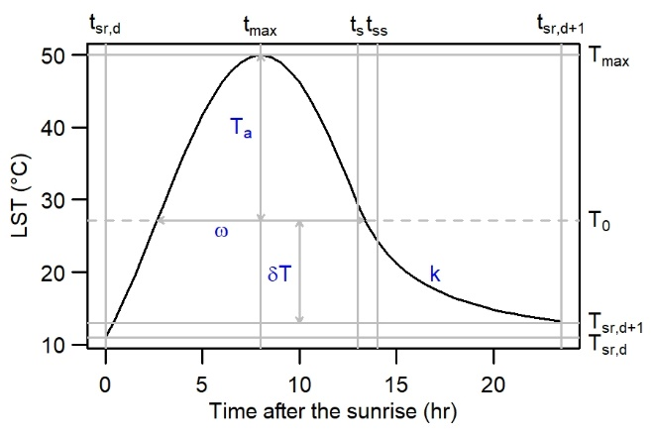
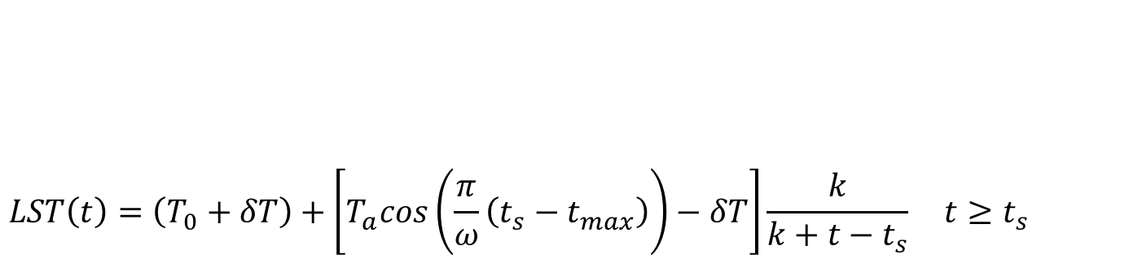
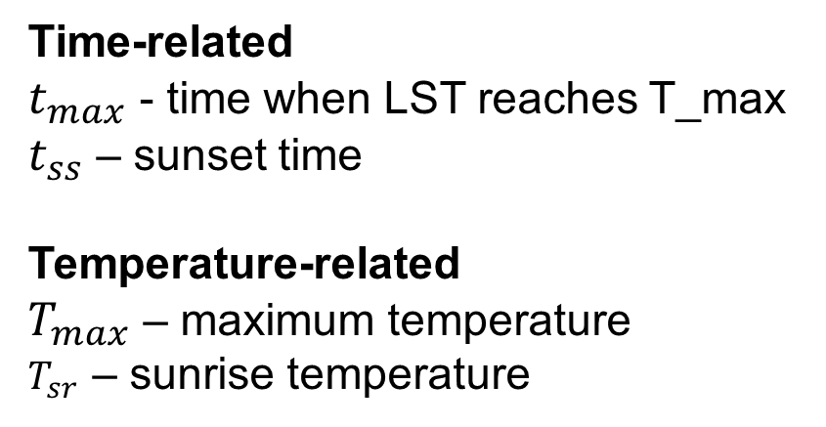
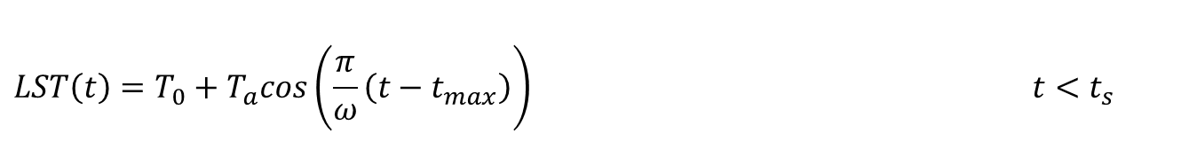
$$LST\left(t\right)=\left(T_{0}+δT\right)+\left[T_{a}cos\left(\frac{π}{ω}\left(t_{s}−t_{max}\right)\right)−δT\right]\frac{k}{k+t−t_{s}} t≥t_{s}$$
$$LST\left(t\right)=T_{0}+T_{a}cos\left(\frac{π}{ω}\left(t−t_{max}\right)\right) t<t_{s}$$
DTC model
Time-related
$t_{max}$ - time when LST reaches T_max $t_{ss}$ – sunset time
Temperature-related
$T_{max}$ – maximum temperature
$T_{sr}$ – sunrise temperature

Slide 6
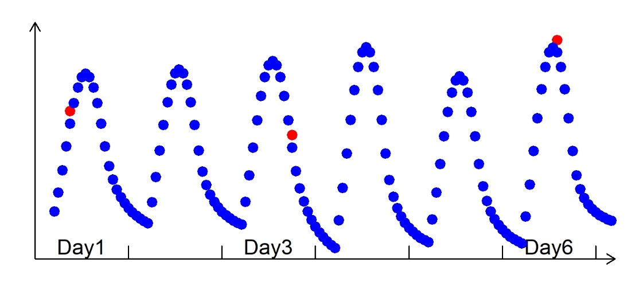
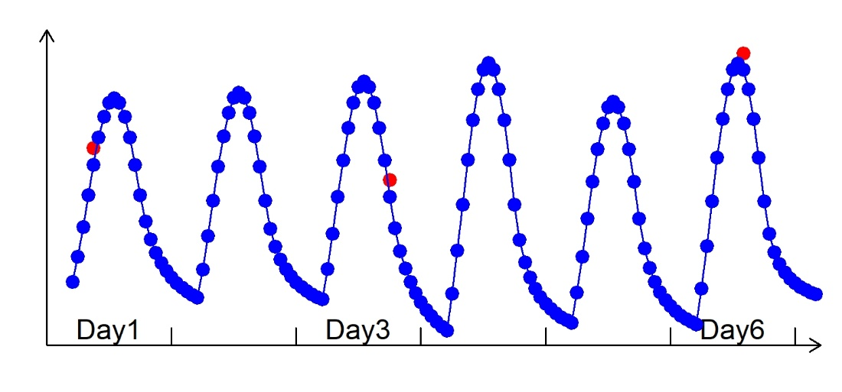
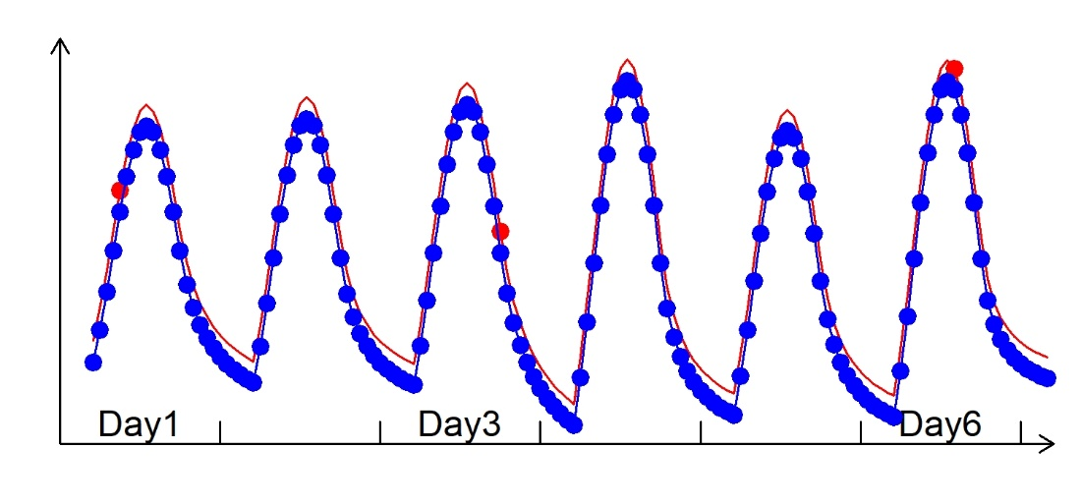
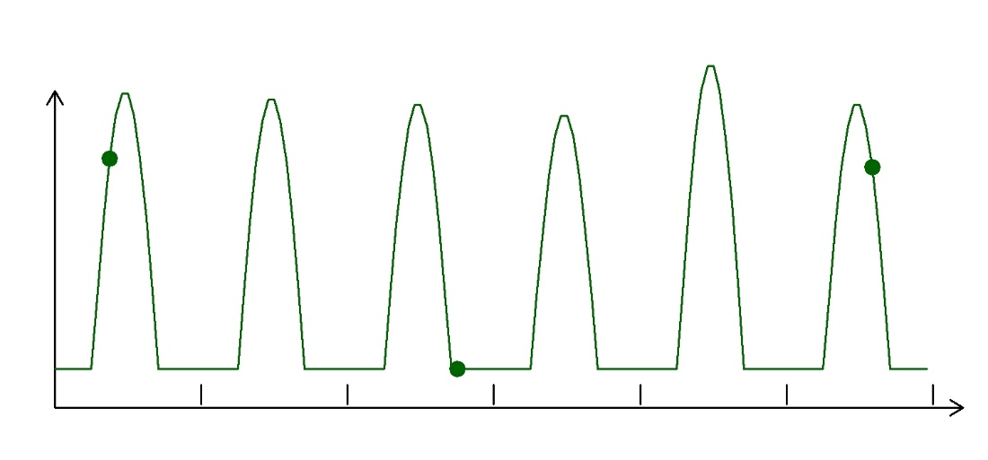
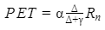
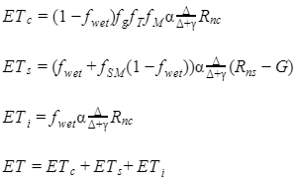
Diurnal sampling characteristics of ECOSTRESS
(Hourly, 2km)
Hu et al. 2020
LST
Diurnal Temperature Cycle (DTC) model
Time-related parameters: t_max, t_ss
Temperature-related parameters: T_max, T_sr
PT-JPL ET model (Fisher et al. 2008, 2020)
ET

Slide 7
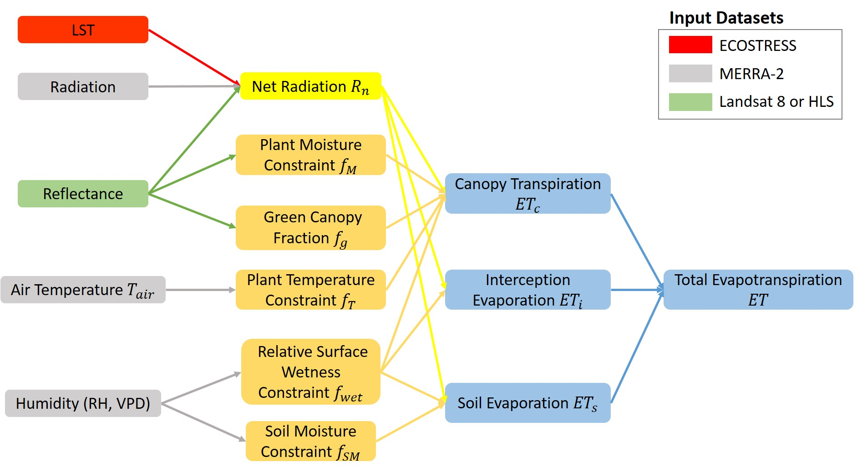
PT-JPL ET model
Priestley and Taylor (1972)
Fisher et al. 2008, 2020

Slide 8
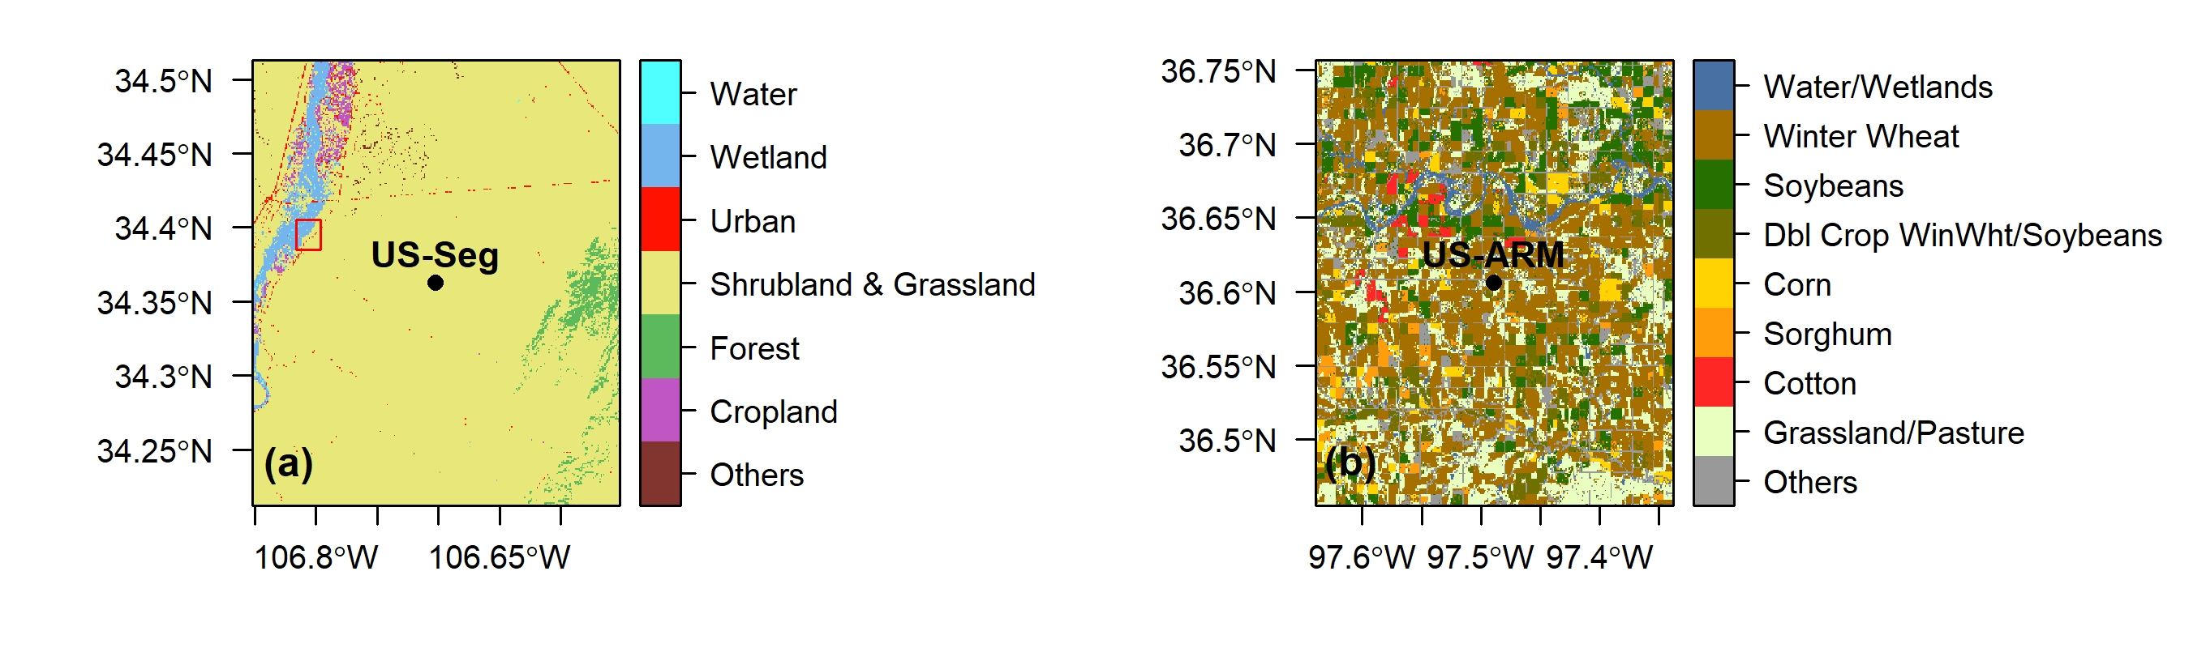
Study domain
Homogeneous
Heterogeneous
US-Seg (34.3623, -106.7020), Sevilleta grassland, NM; PI: Marcy Litvak
US-ARM (36.6058, -97.4888), Southern Great Plains – Lamont, OK; PI: Sebastien Biraud
Time periods
Three distinct phenological stages:
Peak: Aug 4-14, 2018
Green up: Apr 7-17, 2020
Senescence: Sept 26 - Oct 5, 2020
Planting: Jun 15-19, 2021

Slide 9
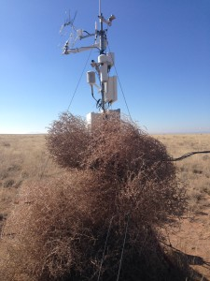
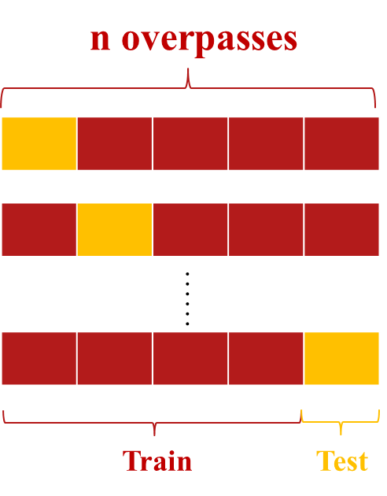
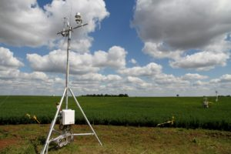
Validation
Validation with ECOSTRESS observations using leave-one-out cross validation approach
Validation with independent flux tower measurements
US-Seg
34.3623, -106.7020
Sevilleta grassland
New Mexico
Vegetation type: Grassland
PI: Marcy Litvak
US-ARM
36.6058, -97.4888
Southern Great Plains – Lamont
Oklahoma
Vegetation type: Cropland
PI: Sebastien Biraud
Best mimic the actual scenario of filling the diurnal gaps with sporadic samplings of native ECOSTRESS observations

Slide 10
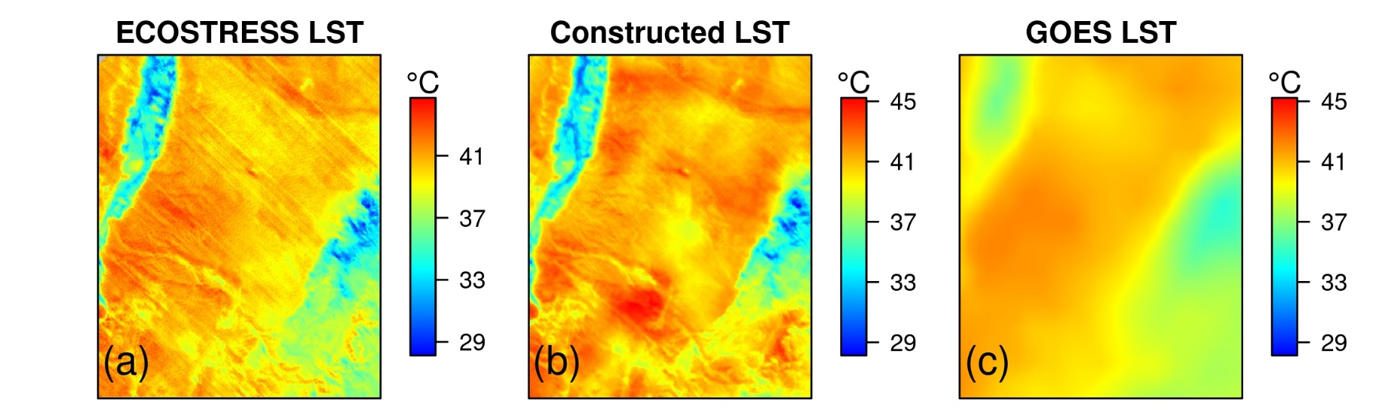
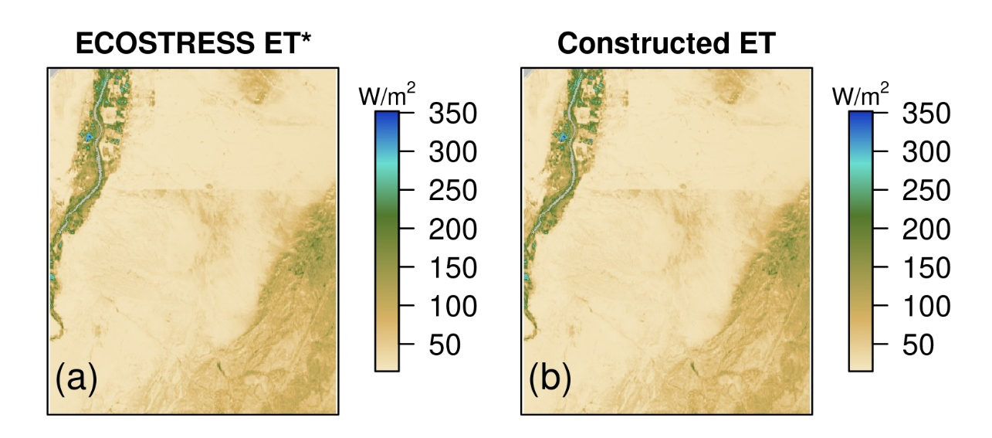
Spatial maps of constructed LST and ET
The constructed LST and ET can greatly capture the fine spatial variation of original ECOSTRESS LST/ET products
27 September 2020, 14:56

Slide 11
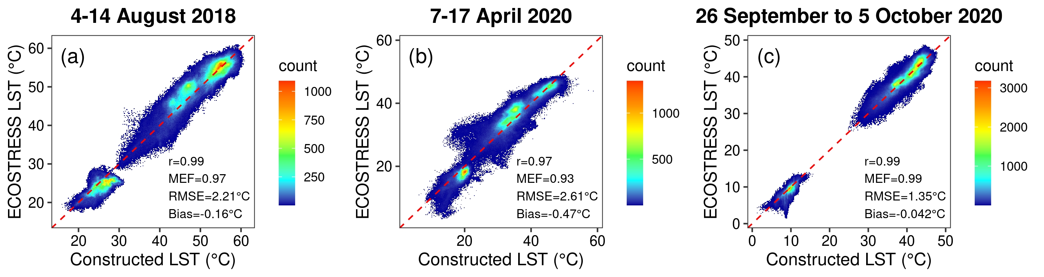
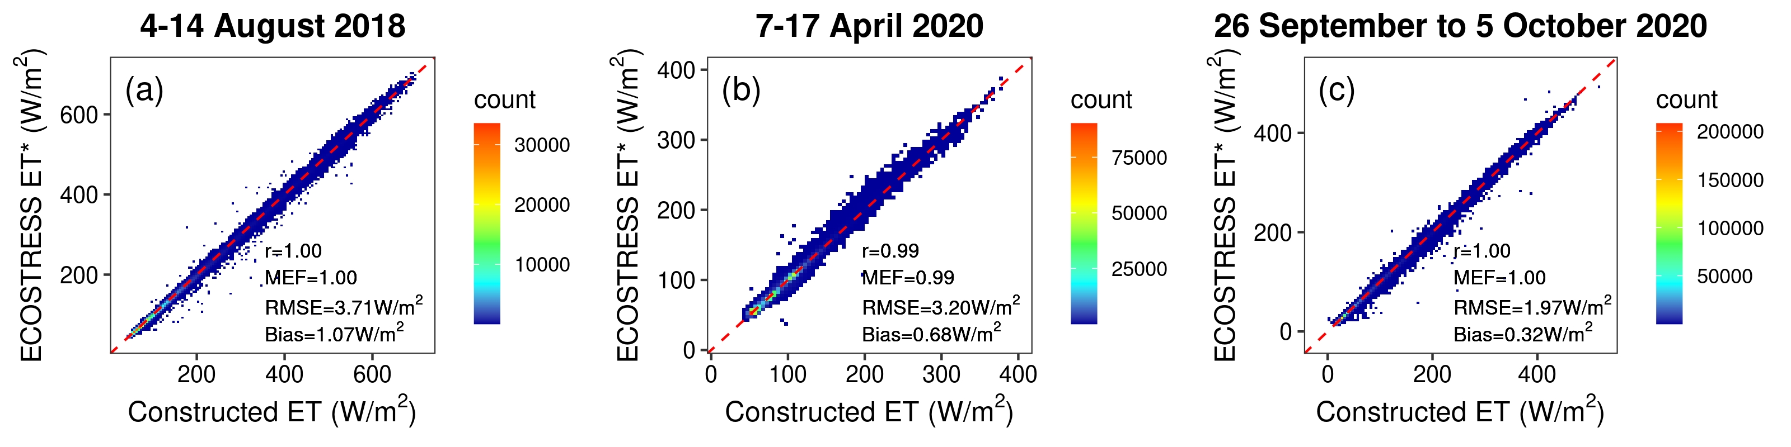
Validation with original ECOSTRESS observations
Peak Season
Green-up
Senescence
LST
ET

Slide 12
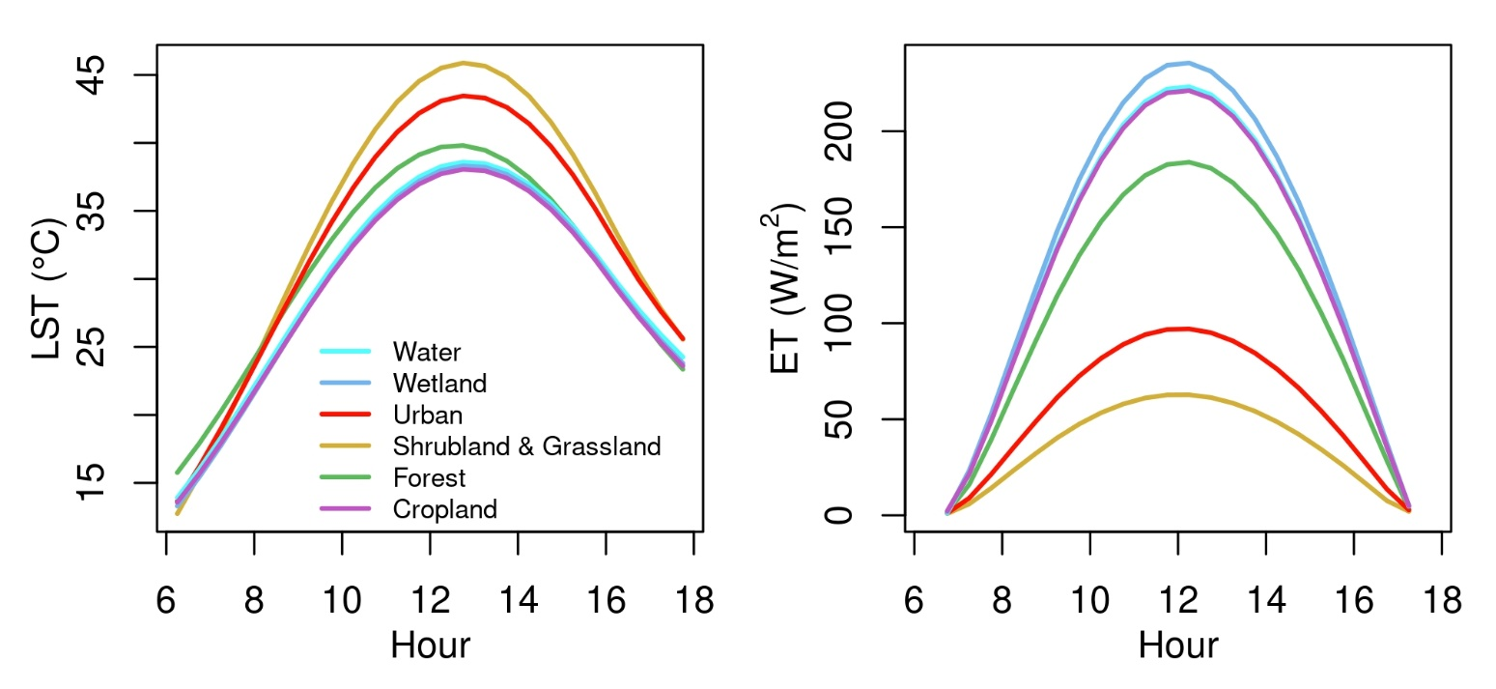
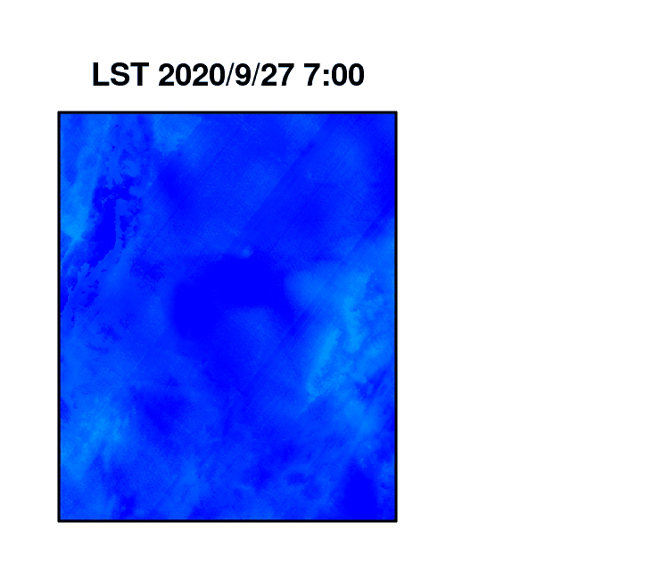
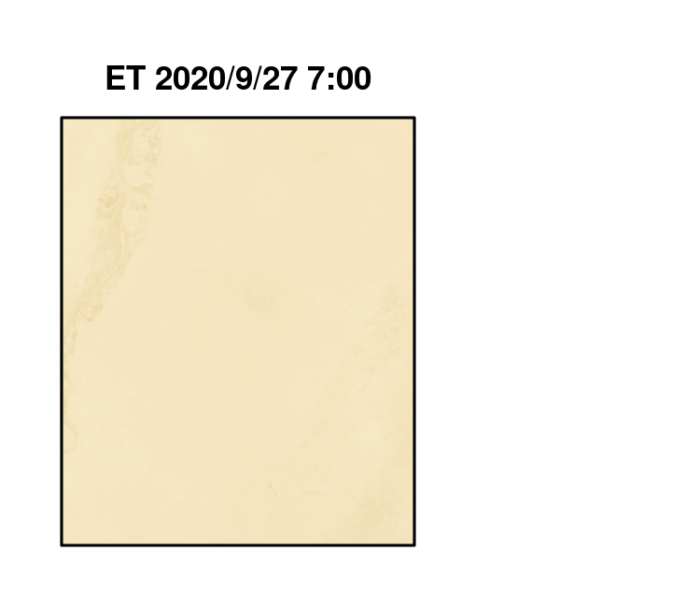
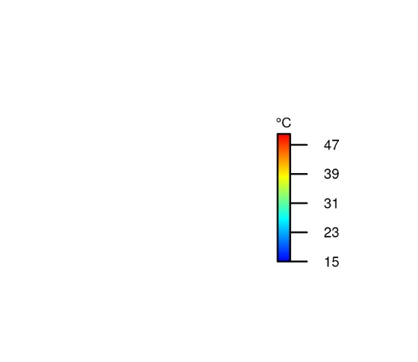
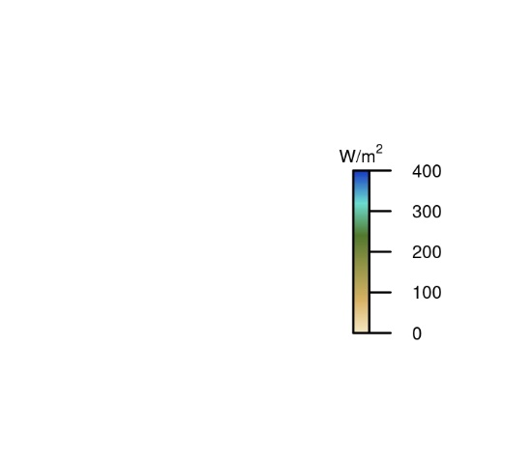
Spatial maps of diurnal variations

Slide 13
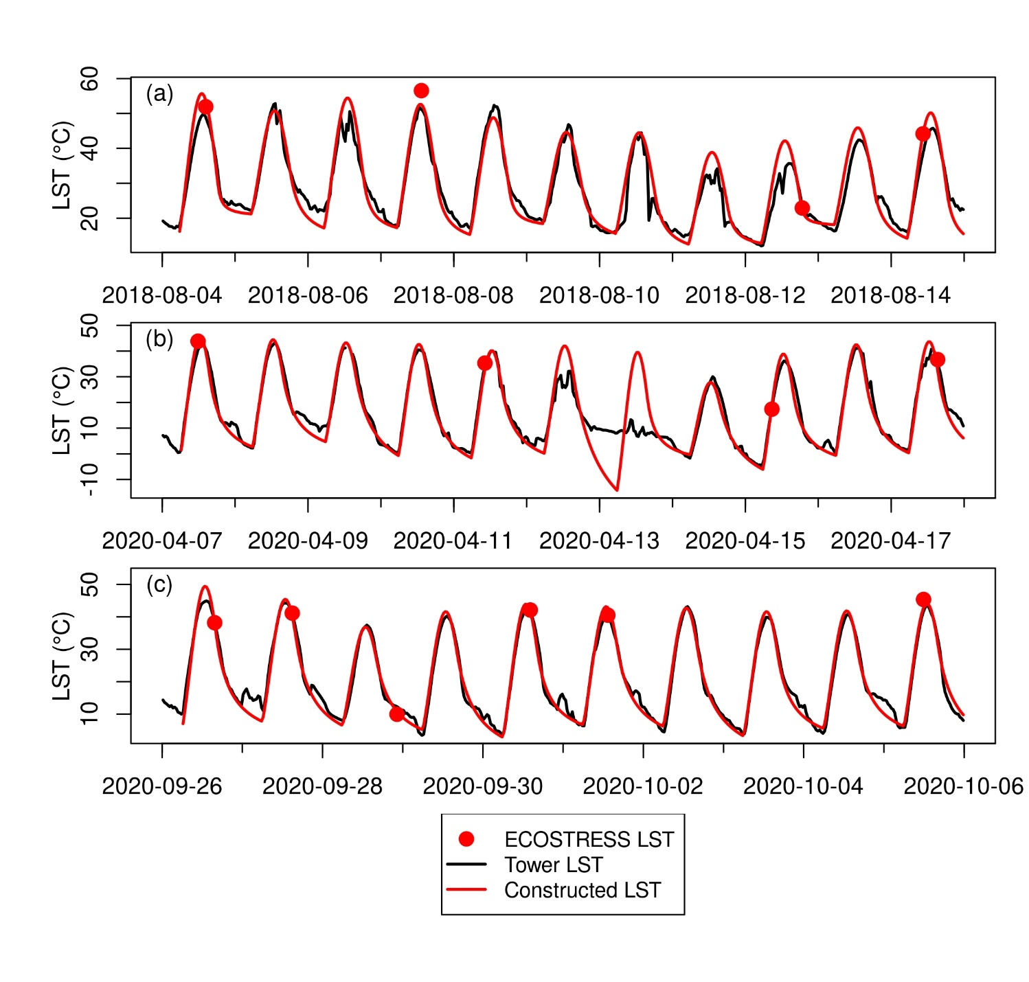
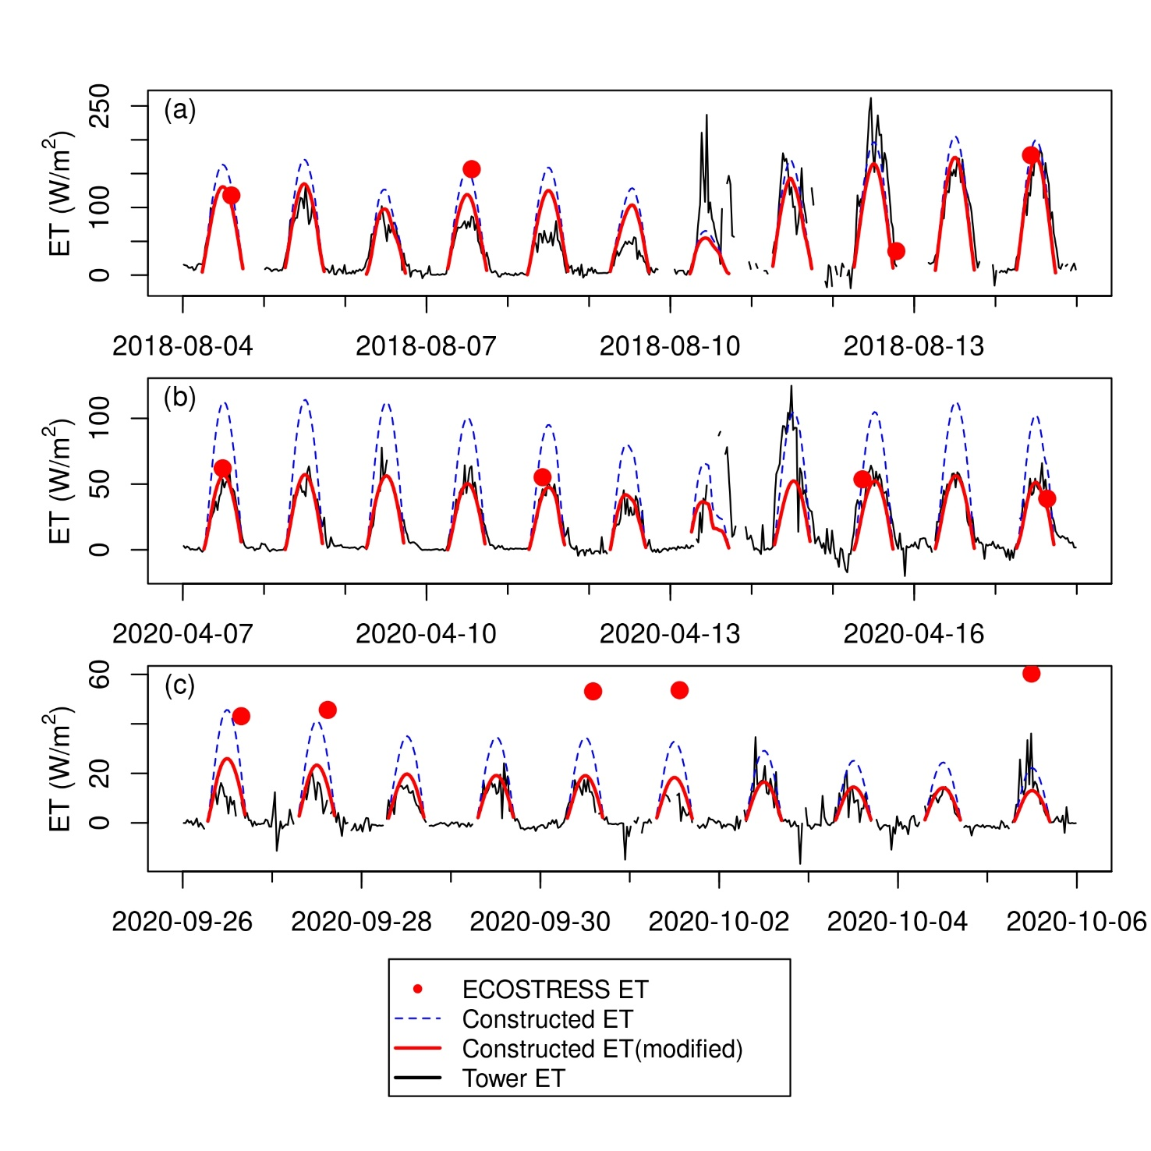
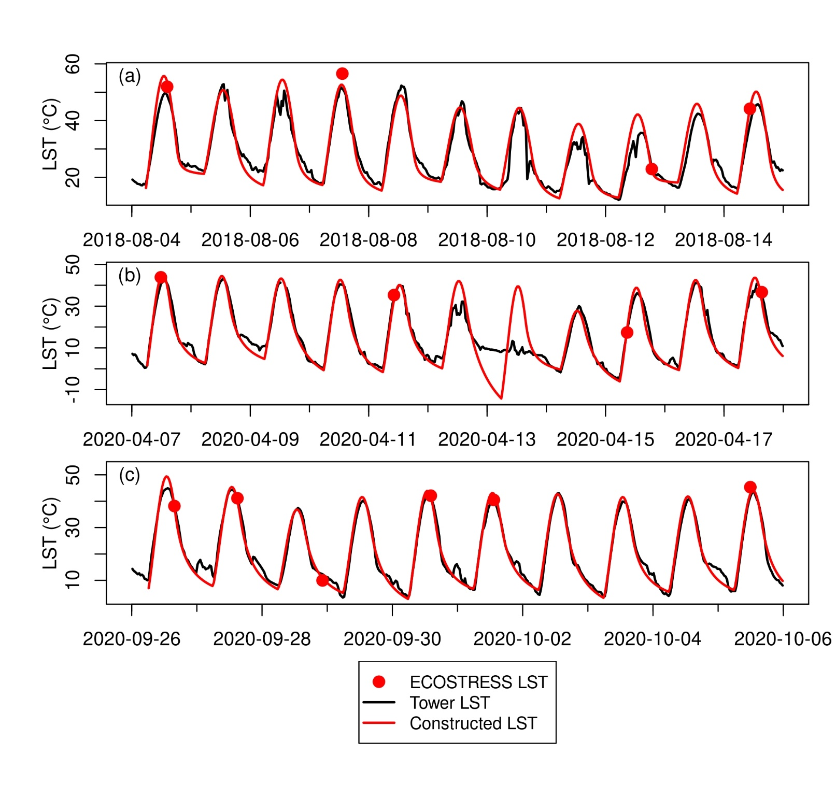
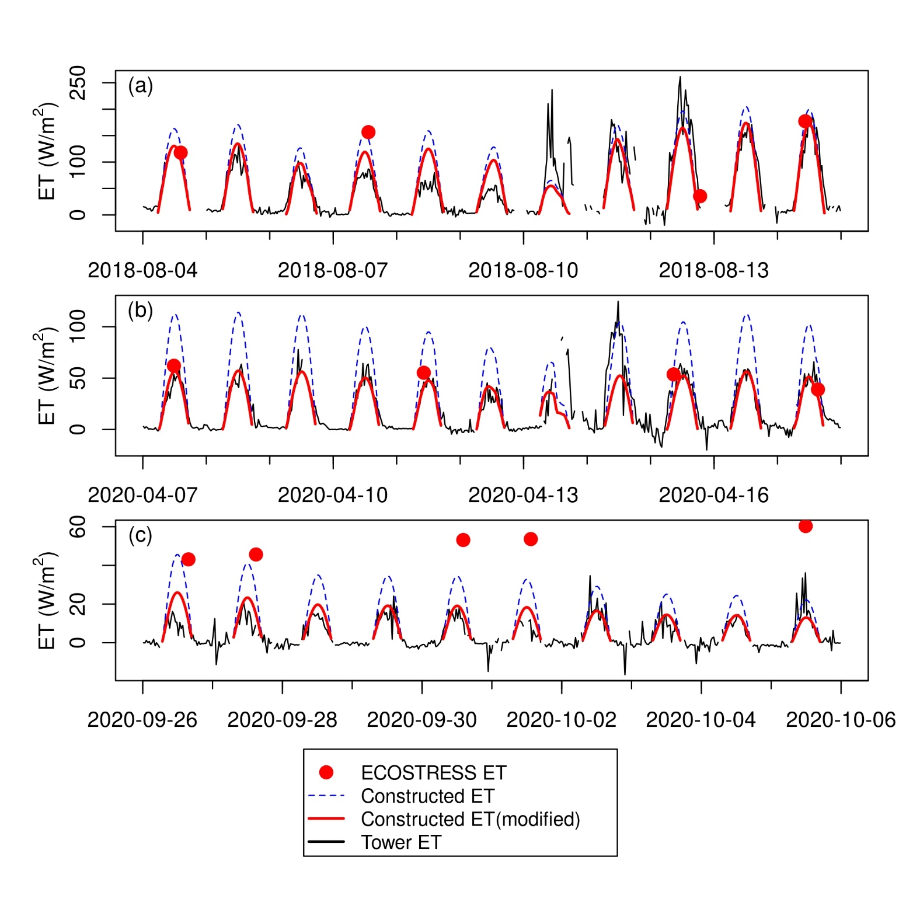
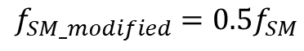
Validation with independent flux tower measurements
Rain event
Rain event
$$f_{SM_modified}=0.5f_{SM}$$

Slide 14
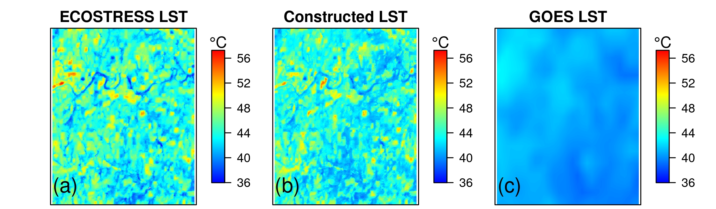
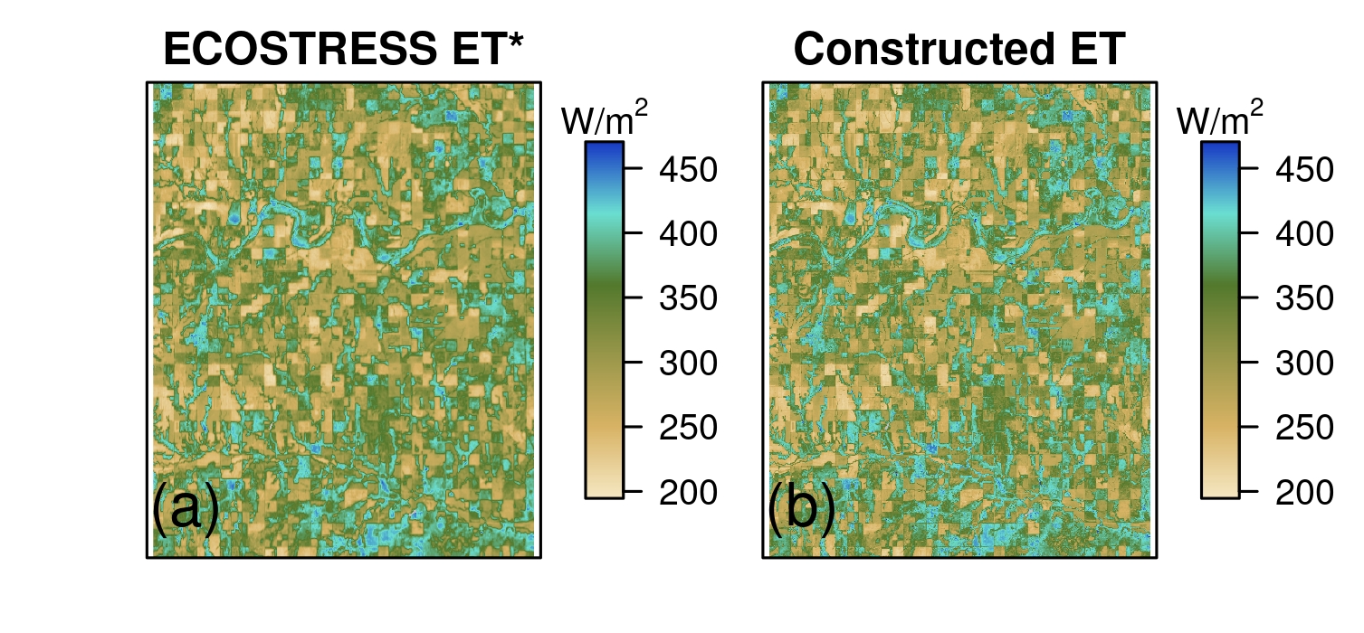
Performance over a heterogeneous landscape
Our framework can reproduce the fine spatial features, even for a heterogeneous landscape.
18 June 2021, 14:24

Slide 15

Summary
We develop the first framework to construct the full diurnal cycle of ECOSTRESS land surface temperature (LST) and evapotranspiration (ET).
The diurnally-resolved 70m LST and ET successfully reproduce the fine spatial variation in the native ECOSTRESS measurements, for both homogeneous and heterogeneous landscapes.
The constructed continuous LST and ET time series consistently capture the diurnal-to-seasonal variations of independent flux tower measurements.
This pilot study sets the stage for testing and applying our framework to broader climates and biome types, eventually towards generating diurnally-resolved 70m global operational LST and ET products, holding great potential in enhancing ecological and agricultural applications.
Contact: jw2495@cornell.edu
@JiamingWen233

Slide 16
Reference
Fisher, J. B., Tu, K. P., & Baldocchi, D. D. (2008). Global estimates of the land-atmosphere water flux based on monthly AVHRR and ISLSCP-II data, validated at 16 FLUXNET sites. Remote Sensing of Environment, 112(3), 901–919. https://doi.org/10.1016/j.rse.2007.06.025
Fisher, J. B., Lee, B., Purdy, A. J., Halverson, G. H., Dohlen, M. B., Cawse‐Nicholson, K., et al. (2020). ECOSTRESS: NASA’s Next Generation Mission to Measure Evapotranspiration From the International Space Station. Water Resources Research, 56(4), 1–20. https://doi.org/10.1029/2019WR026058
Hu, L., Sun, Y., Collins, G., & Fu, P. (2020). Improved estimates of monthly land surface temperature from MODIS using a diurnal temperature cycle (DTC) model. ISPRS Journal of Photogrammetry and Remote Sensing, 168, 131–140. https://doi.org/10.1016/j.isprsjprs.2020.08.007
Priestley, C. H. B., & Taylor, R. J. (1972). On the assessment of surface heat flux and evaporation using large scale parameters. Monthly Weather Review, 100, 81−92.

